Slide 1


UNDERSTANDING SUCCESSFUL
SOCCER PERFORMANCES
DEAN, JENNIE, JOSE, AND LOIC

Slide 2

DATA OVERVIEW
2 datasets: Matches and EloRatings
Match history spans from 2000–2024
226k matches
900 teams from all major leagues worldwide
Game statistics (Shots, Fouls, Corners, Yellow Cards)

Slide 3
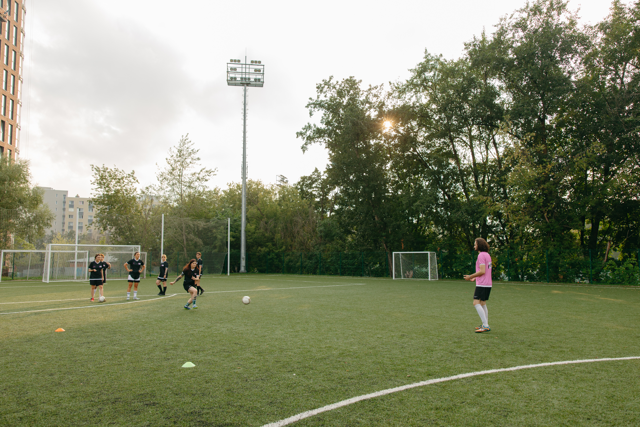
RESEARCH QUESTION
How is success measured and what factors affect a team’s success?
Audience: Coaches, analysts who want to learn about what makes a team successful beyond just winning trophies

Slide 4
HOW IS SUCCESS MEASURED?
Indicates a team’s skill level
Based on:
Match performance
Strength of opponents
Consistency
ELO RATINGS

Slide 5
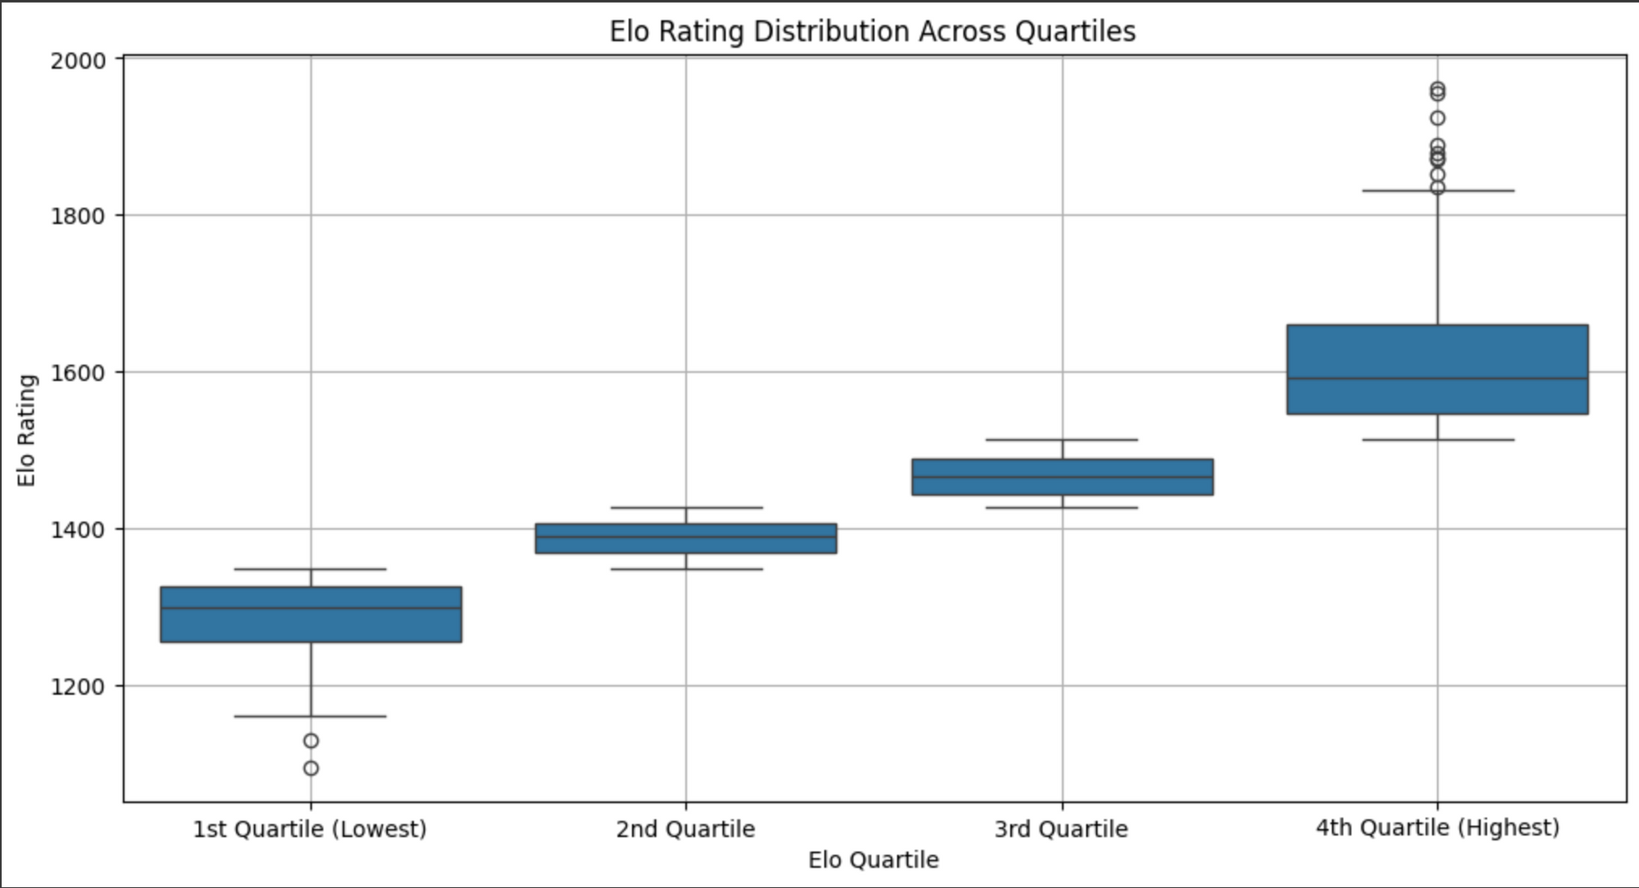
HOW ARE THE TEAMS CATEGORIZED?
BASED ON ELO RATINGS
Notes:
The maximum was 2100 and the minimum was 1100. So I added some to the bottom and took some off the top and got the values.

Slide 6
HOW ARE THE TEAMS CATEGORIZED?
BASED ON ELO RATINGS
1617.02
1285.83
Notes:
The maximum was 2100 and the minimum was 1100. So I added some to the bottom and took some off the top and got the values.

Slide 7
HOW ARE THE TEAMS CATEGORIZED?
BASED ON ELO RATINGS
TOP 25%
(4th quartile)
LOWEST 25%
(1st quartile)
224 teams
130k games (550 games each team)
Avg elo rating: 1600 (9 teams above 2000)
224 teams
115k games (500 games each team)
Avg elo rating: 1300
GOOD TEAMS
BAD TEAMS
Notes:
The maximum was 2100 and the minimum was 1100. So I added some to the bottom and took some off the top and got the values.

Slide 8
HOW IS SUCCESS MEASURED?
What factor affect Elo ratings?
ELO RATINGS

Slide 9
HOW IS SUCCESS MEASURED?
What factor affect Elo ratings?
POINTS MEASURING
ELO RATINGS
A system used to assign points to teams in a league or tournament based on match results
3 game form
5 game form
WIN = 3 POINTS, DRAW = 1 POINTS, LOSS = 0 POINTS

Slide 10
WHAT IS GAME FORM?
3 GAME FORM
Tracks a teams performance over the last 3 games
Game form is calculated by adding up points from the last 3 games.
Ex. (3+1+0) = 4 points
After each match, the oldest result is removed, and the latest result is added
Game 1 | Win | 3 points
Game 2 | Draw | 1 point
Game 3 | Loss | 0 point
Notes:
Start with the general what the 3 game form is. No need for the win, loss, tie stuff on side because it distracts from what they are trying to get. Just need the points since that is what we are talking about.

Slide 11
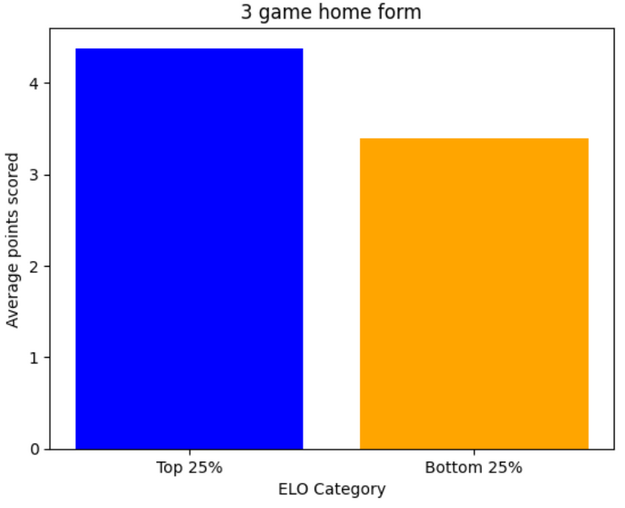


HOME GAME PERFORMANCE
1 point
2 points
Good teams perform well at home to keep the winning streak alive
Bottom 25% teams lack the consistency to dig themselves out of hole if they have a bad game
Notes:
Good teams have strong supporters and tend to just player better overall when at home.
The good team consistency helped grow the gap from 4 points to 7 points.
This goes to show that the low-elo teams need to work on performing better at home, since this is where they drop most of their points.
Start with axis explanation, then talk about the gap, then explain what that means and why it's there.

Slide 12
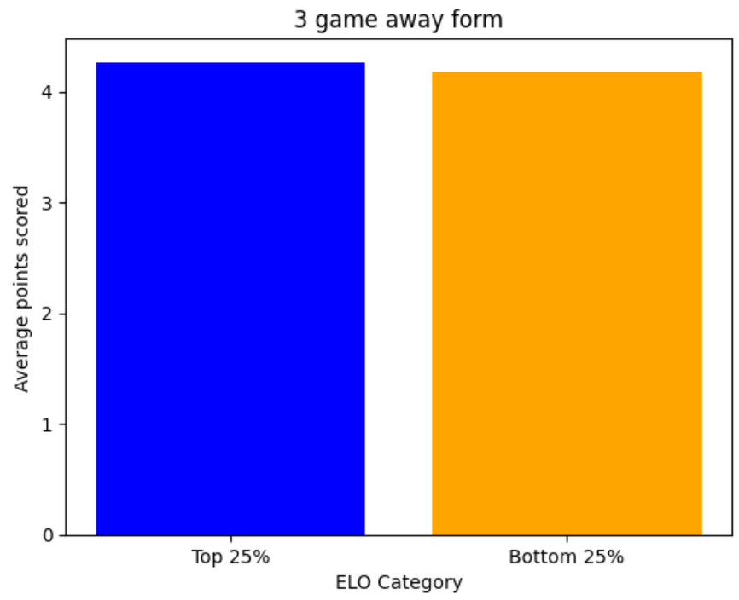
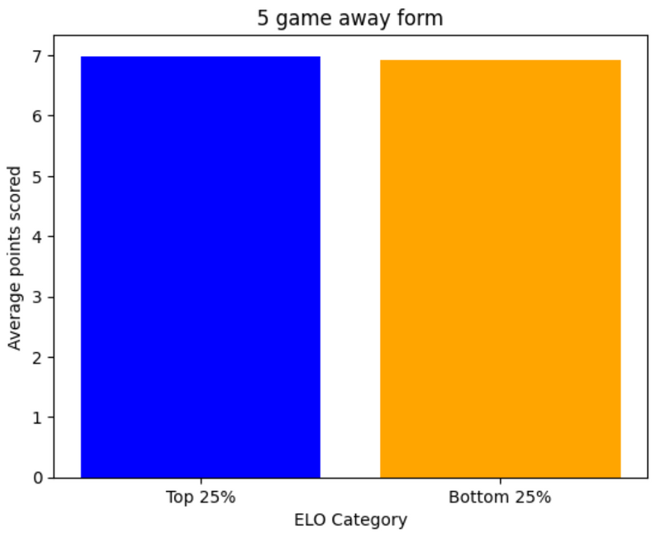
AWAY GAME PERFORMANCE
Much harder to win on the road since the conditions are against you
Top 25% teams play more cautiously away, adjusting their strategy to maintain control
Notes:
Weaker teams tend to play with less pressure, they focus on defending, then going to counter attack and score
Stronger teams play more cautious because they don't want to expose themselves
Start with axis explanation, then talk about why there is no gap, then explain what that means and why it's there.

Slide 13
WHAT FACTORS AFFECT ELO RATINGS?
What factor affect a team performance?
SHOT DIFFERENCE
POINTS
CORNER DIFFERENCE
TEAM DISCIPLINE

Slide 14
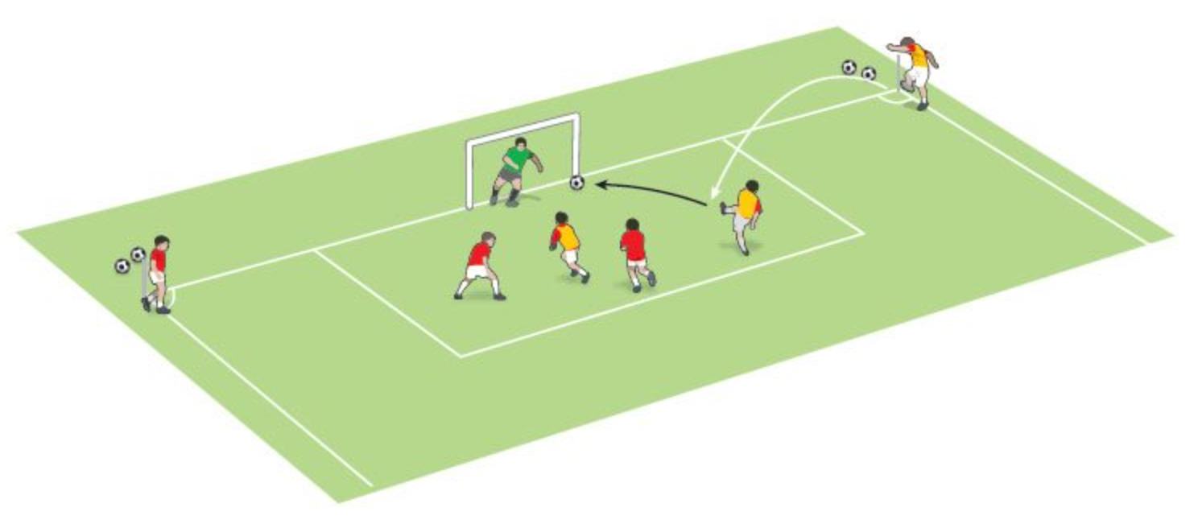
SHOT DIFFERENCE
Measures which team has taken more shots in the game.
ie. Shot Difference = Shots taken by Team A - Shots taken by Team B

Slide 15
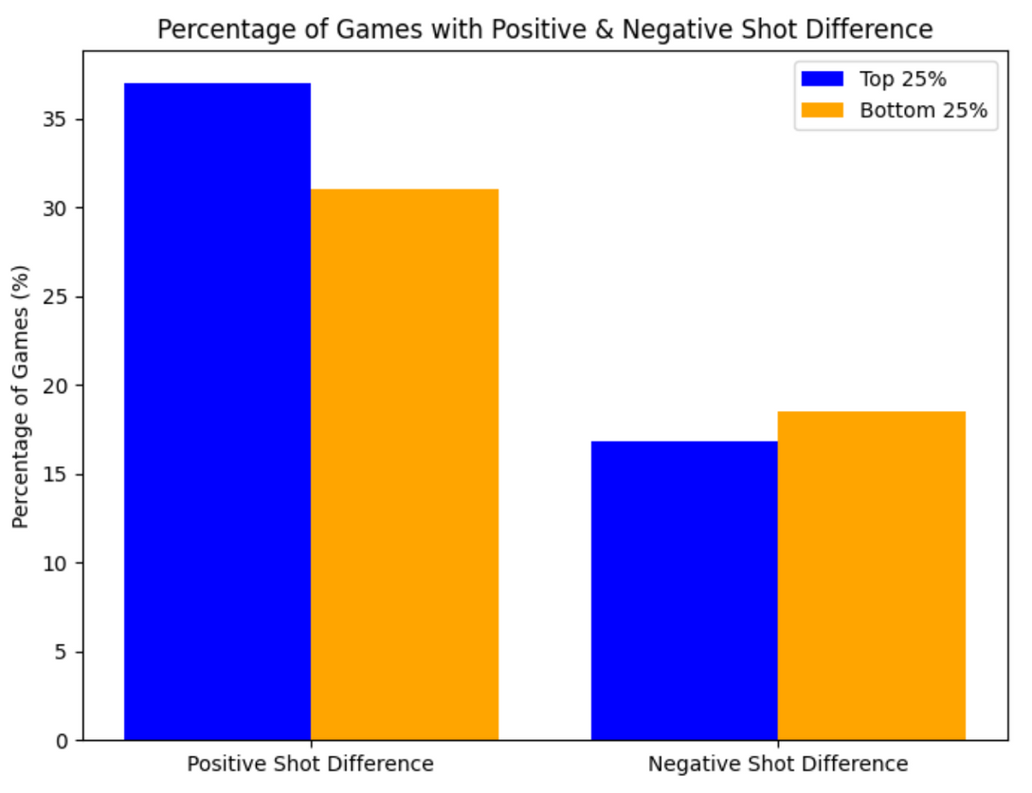
SHOT DIFFERENCE
Top 25% ELO teams control shot difference more often but don’t rely on it as much for success. They can still perform well even when outshot.
Bottom 25% ELO teams are less consistent in outshooting opponents and rely more on shot advantages to maintain good form.
Notes:
The positive shot difference means that team outshot their opponents.
The Top 25% teams tend to have a higher positive shot difference than the Bottom 25% teams. And have a lower Negative shot difference than the bottom 25% teams.
This shows that the Top 25% teams tend to control the game more and create more opportunities since they have a higher percentage of games with a positive shot difference and a lower percentage of games with negative shot difference.
Despite top ELO teams having more shots than their opponents, their shot difference correlation with form is low. Means that even if they don't have more shots they are still effective with them. They rely more on good players and tactics to win them games.
However, shot difference has a higher correlation with form for low ELO teams. This means that they need to generate more shots than their opponents to achieve better results.

Slide 16
CORNER DIFFERENCE
Measures which team has taken more corners in the game
ie. Corner Difference = Corners taken by team A - Corners taken by team B

Slide 17
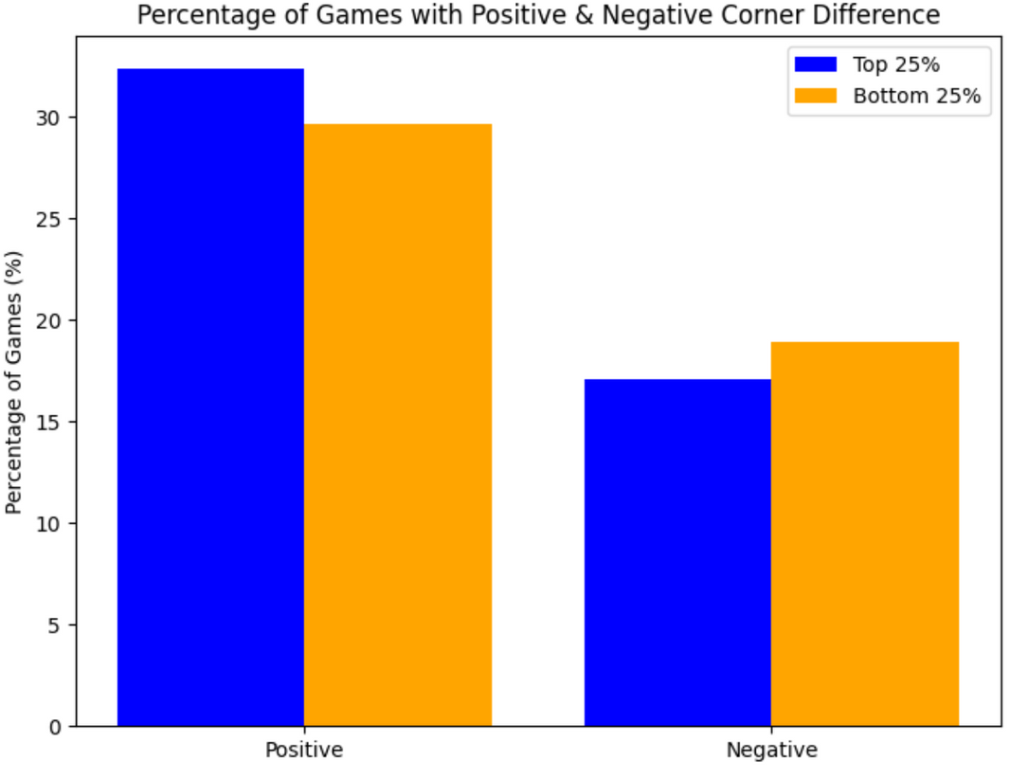
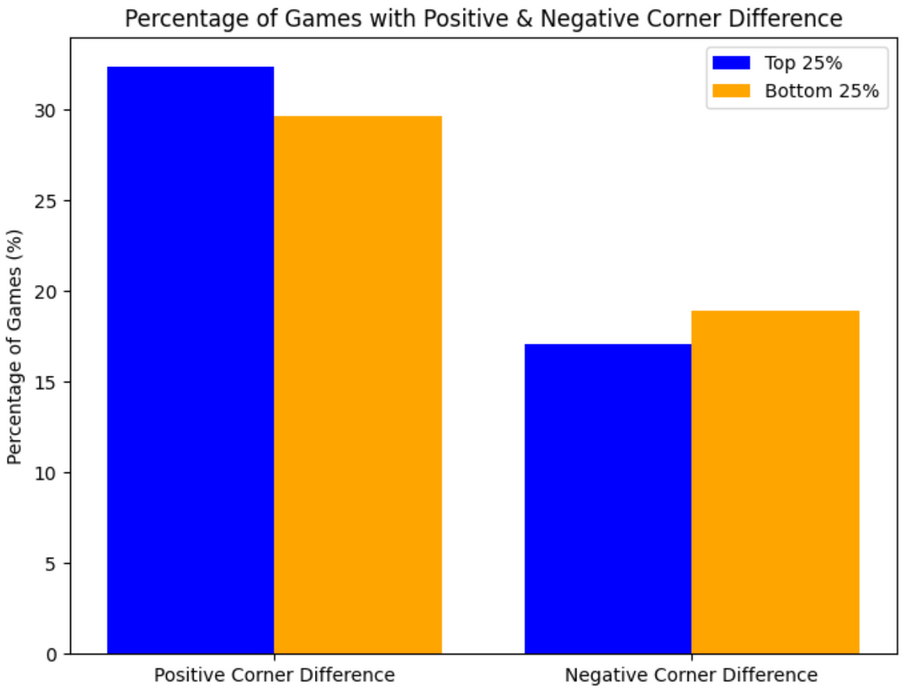
CORNER DIFFERENCE
Top 25% ELO teams earn more corners in games but don’t heavily depend on them to maintain strong performances.
Bottom 25% ELO teams struggle to win as many corners and tend to benefit more when they do. Gaining a corner advantage plays a bigger role in their overall performance.
Notes:
The positive corner difference means that team had more corners their opponents.
The Top 25% teams tend to have a higher positive corner difference than the Bottom 25% teams. And have a lower Negative corner difference than the bottom 25% teams.
This shows that the Top 25% teams tend to control the game in the attacking half and create more opportunities since they have more corners.
Despite top 25% teams having more corners than their opponents, their corner difference correlation with form is low. Means that even if they don't have more corners they are still effective with them. They rely more on good attackers scoring important opportunities and team tactics.
However, corner difference has a higher correlation with form for low ELO teams. This means that they need to generate more corners than their opponents to achieve better results.

Slide 18
TEAM DISCIPLINE
How discipline and performance dynamics across teams
Fouls frequency
Yellow cards

Slide 19
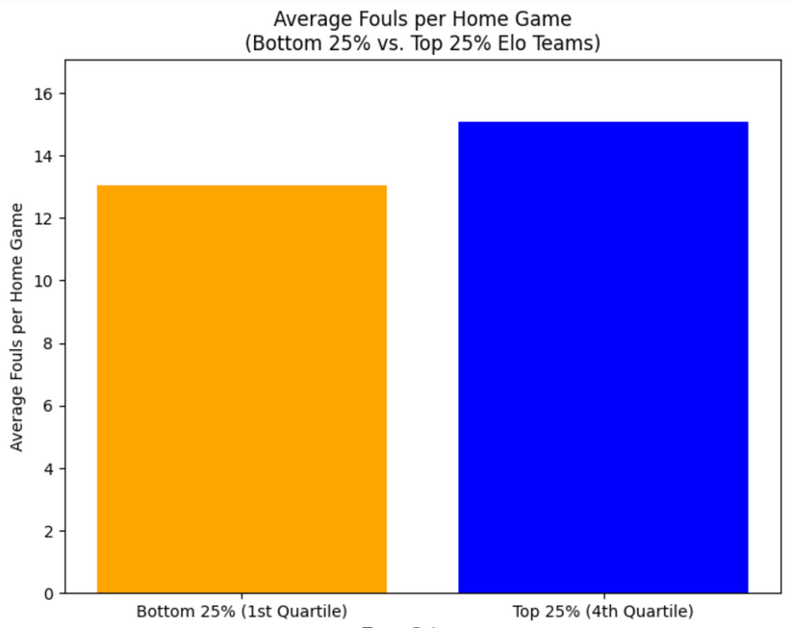
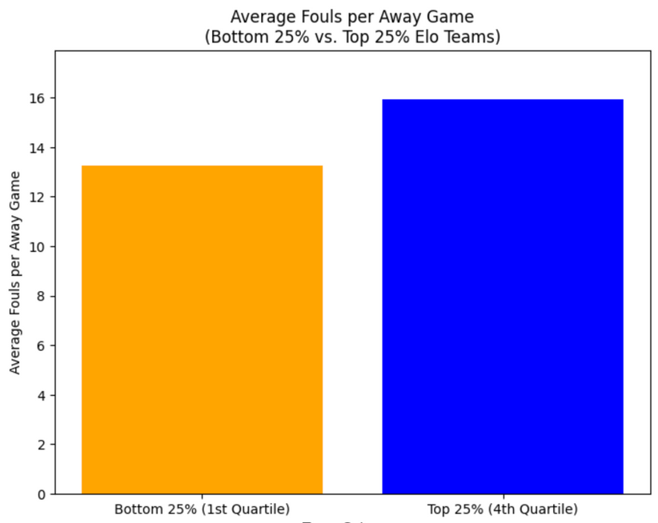
FOULS FREQUENCY
HOME GAME
AWAY GAME
15
16
13
13.5
Top 25% ELO teams might play more aggressively or more confident with attacking strategies compare to Bottom 25% teams, whether they play at home or away

Slide 20
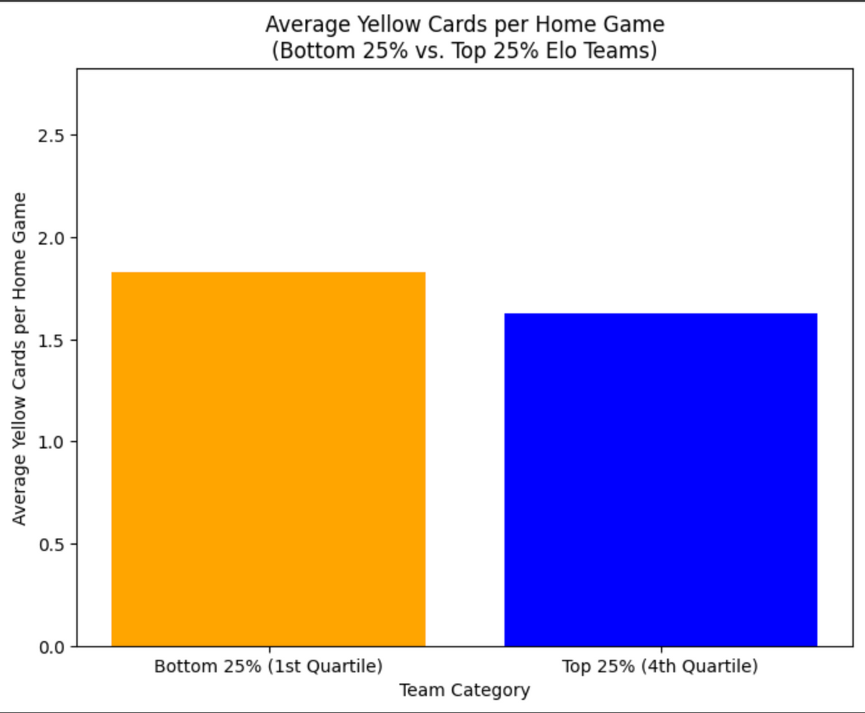
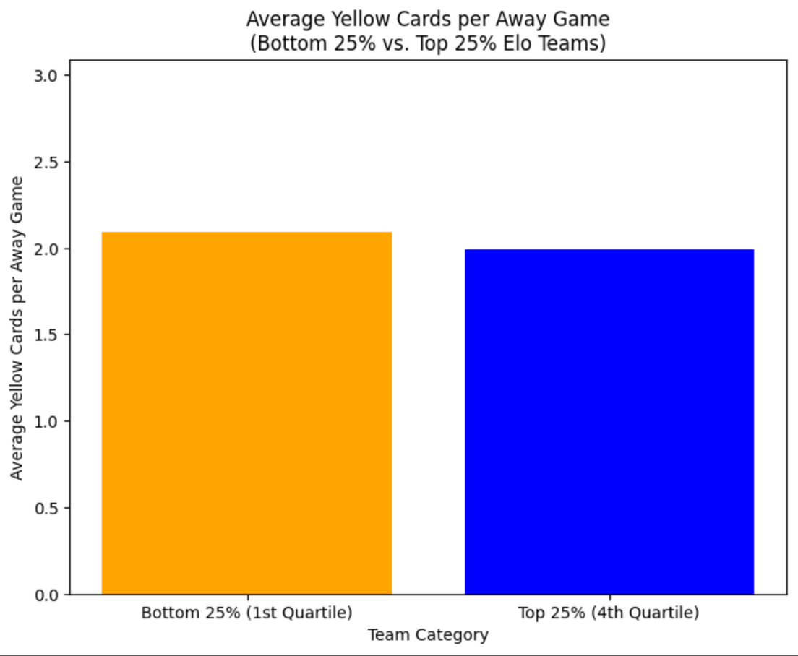
YELLOW CARDS FREQUENCY
HOME GAME
AWAY GAME
Both team categories receives 1 - 2 yellow cards per game
At home game, Top 25% ELO teams tend to display better discipline

Slide 21
CONCLUSION
In general, teams perform better at home game rather than away game
Top 25% teams tend to outshoot and have more corners than their opponents.
Bottom 25% teams are less consistent than Top 25% teams at outshooting and having more corners.
They also rely more on these factors for their form.
Top 25% ELO teams might play more aggressively or more confident with attacking strategies compare to Bottom 25% teams

Slide 22
THANK YOU!

